Slide 1
Case Study One
Maojie Xia
Joseph Woodall
Gotham Katta

Slide 2
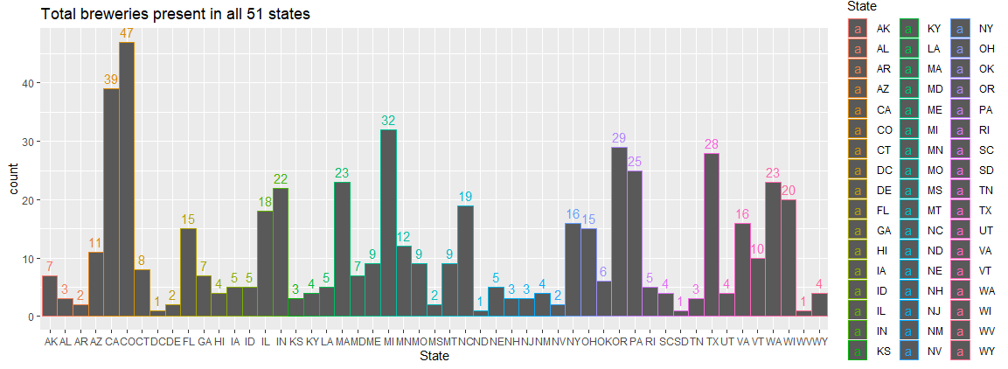
Question 1
How many breweries are present in each state?
Notes:
After examining the summary statistics of each column in the breweries dataset, I found that there are about 10 breweries per state, with a minimum of 1 and a maximum of 47 breweries in any given state. You may find a breakdown of each state and its brewery count below.

Slide 3
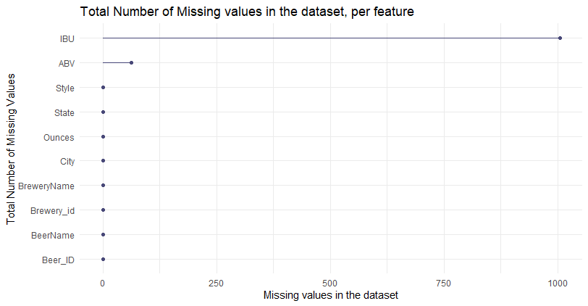
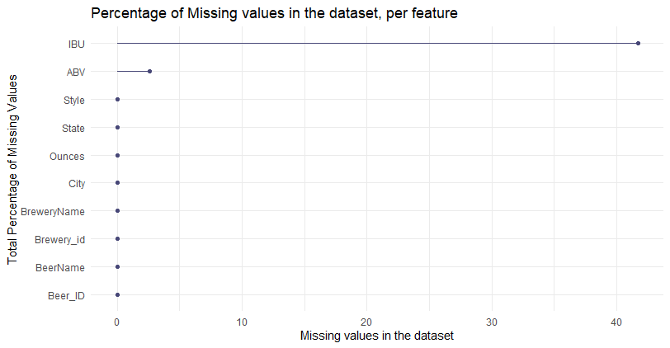
Question 3
ABV has 62 missing values
IBU has 1005 missing values
Notes:
By running a function which finds null values in the new TotalData dataset, I found that the only columns to contain missing values were ABV and IBU. This could be a potential risk in any analysis using these features as it might lead to misleading, or unrepresentative, results. It would be wise to proceed with caution.

Slide 4
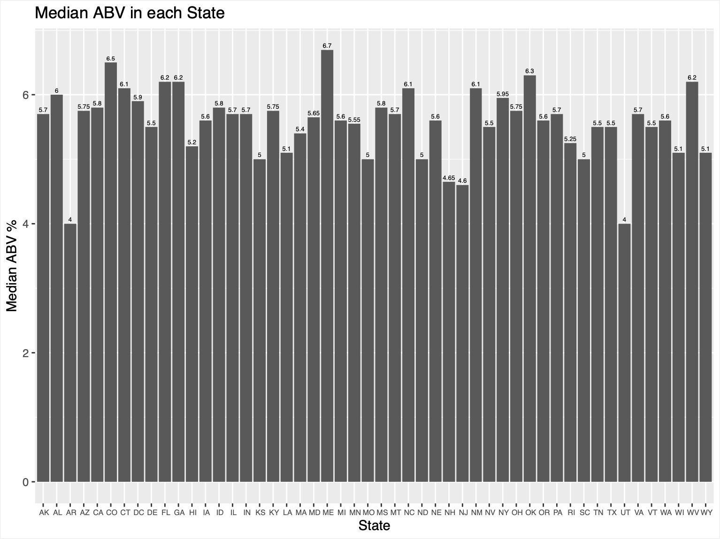
Question 4
Median alcohol content in each state?
Notes:
The states with the lowest median ABV are Arizona and Utah, with an alcohol content of 4%.
The state with the highest median ABV is Maine, with an alcohol content of 6.7%.
The median alcohol content of all 50 states is 5.56%.
The median alcohol content has a range of 2.7, which honestly is not that high.

Slide 5
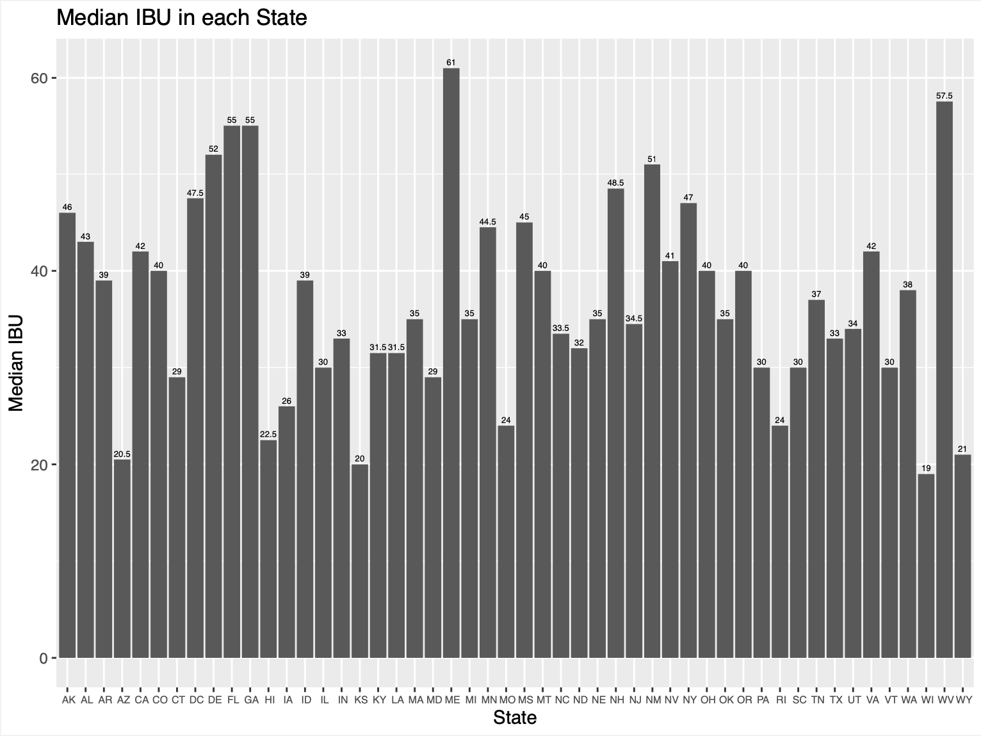
Question 4 (cont.)
Median international bitterness unit in each state?
Notes:
The state with the lowest international bitterness unit is Wisconsin, with an IBU value of 19.
The state with the highest international bitterness unit is Maine, with an IBU value of 61.
Again, Maine comes up with the highest median value.
The median international bitterness unit of the all 50 states is 36.98 (so around 37).
The median international bitterness unit has a range of 42, which is pretty high.

Slide 6
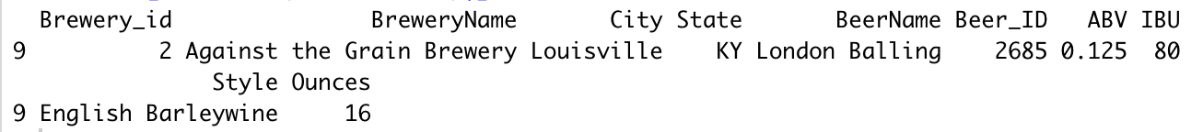
Question 5
Which state has the highest beer content (ABV)?
Kentucky with ABV of 12.5%
Notes:
The state with the maximum alcohol by beer volume is Kentucky, with an alcohol content of 12.5%. However, this is after we removed any breweries with missing values.
The state with the maximum alcohol by beer volume, before we removed any missing values, is Colorado, with an alcohol content of 12.8%.

Slide 7
Question 5 (cont.)
Which state has the highest beer content (ABV)?
But if you include missing values then...
Colorado with ABV of 12.8%

Slide 8
Question 5 (cont.)
Which state has the most bitter (IBU) beer?
Oregon with IBU of 138
Notes:
The state with the maximum internationally bitterness unit is Oregon, with an IBU of 138.

Slide 9

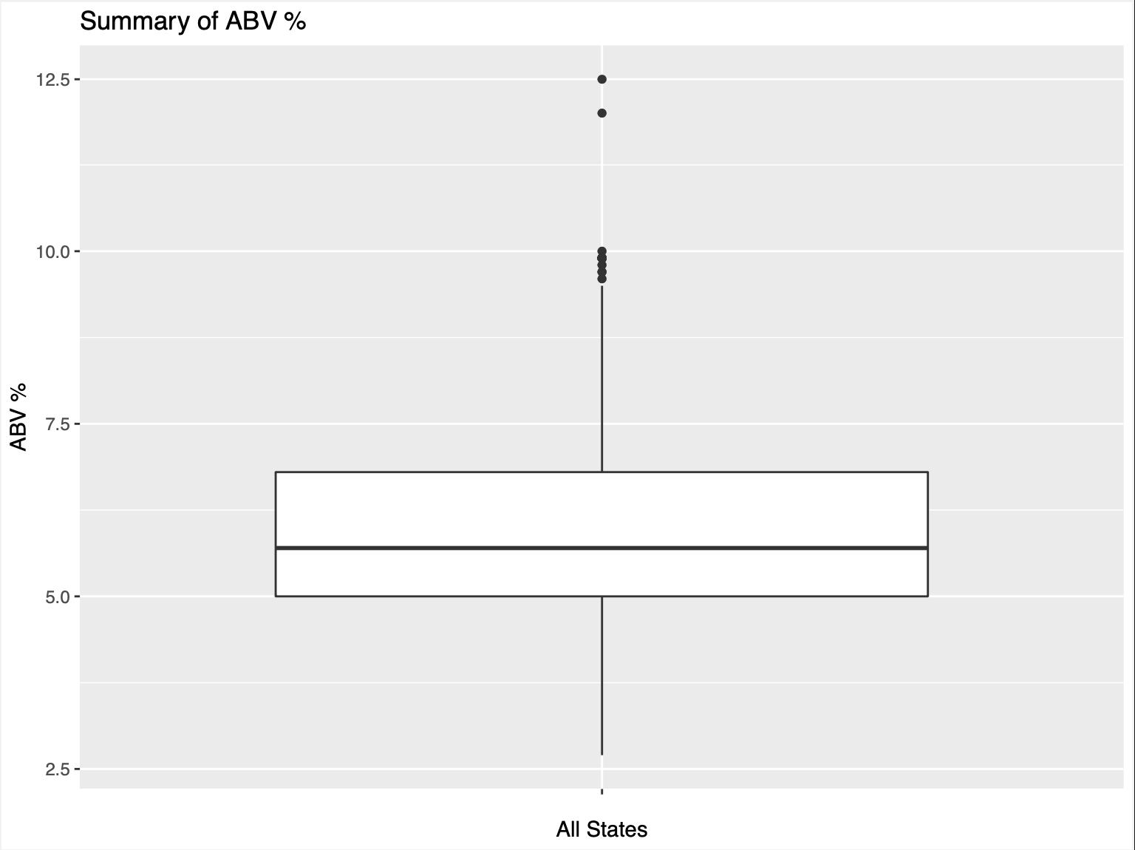
Question 6
50% of beers have an ABV between 5% and 6.8%
The median ABV = 5.7%
The mean ABV = 6%
There are a few outliers over 10% ABV

Slide 10
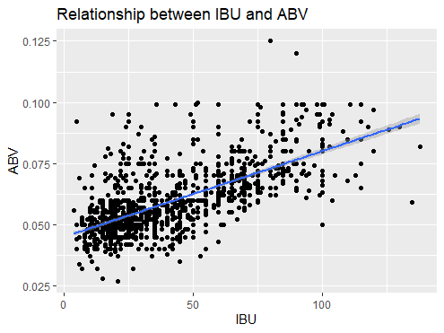
Question 7
Cor = 0.67
There is a positive correlation between
the bitterness of the beer and its alcoholic content.
As IBU increases, ABV also increases.

Slide 11
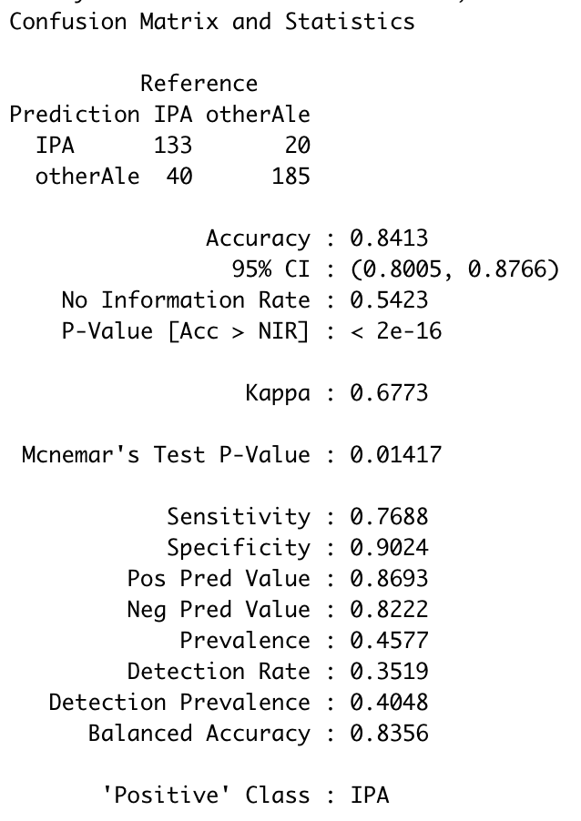
Question 8
When predicting IPA or Ales, we can do so with 84% accuracy.
We can predict IPA correctly, 78% of the time.
And we can predict Ales, 90% of the time.
Notes:
Using KNN classifier, the model performed with: an accuracy of 84%, a sensitivity of 78%, and a specificity of 90%.
a specificity of 90%.
We are 95% confident that any given value of IBU and ABVs will be accurately predicted it as an India Pale Ale if it falls between the interval (0.81, 0.88). These statistics were found using a k value = 39.

Slide 12
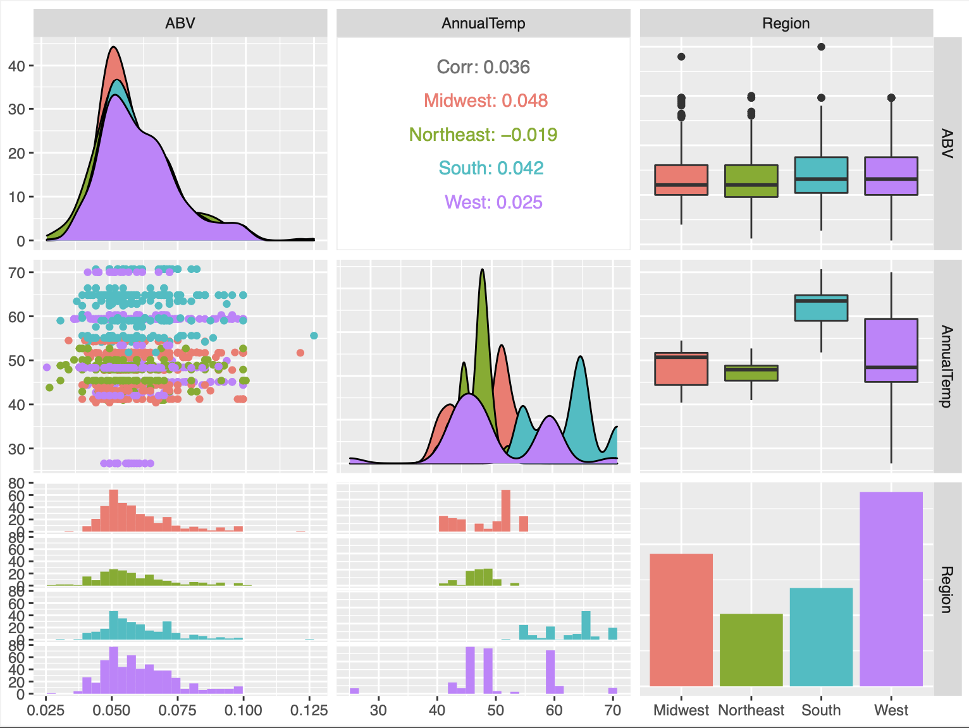
Question 9
The ABV in each region are very similar.
Small correlation between annual temperature and ABV in each region.
The Midwest and South have higher annual temperatures and higher ABVs.
Notes:
Despite there being a difference in the average annual temperature in each region, the average ABV in each region is very similar.
Although it is a small correlation, the regions with the highest annual temperature (the Midwest and the South) have slightly higher ABVs.

Slide 13
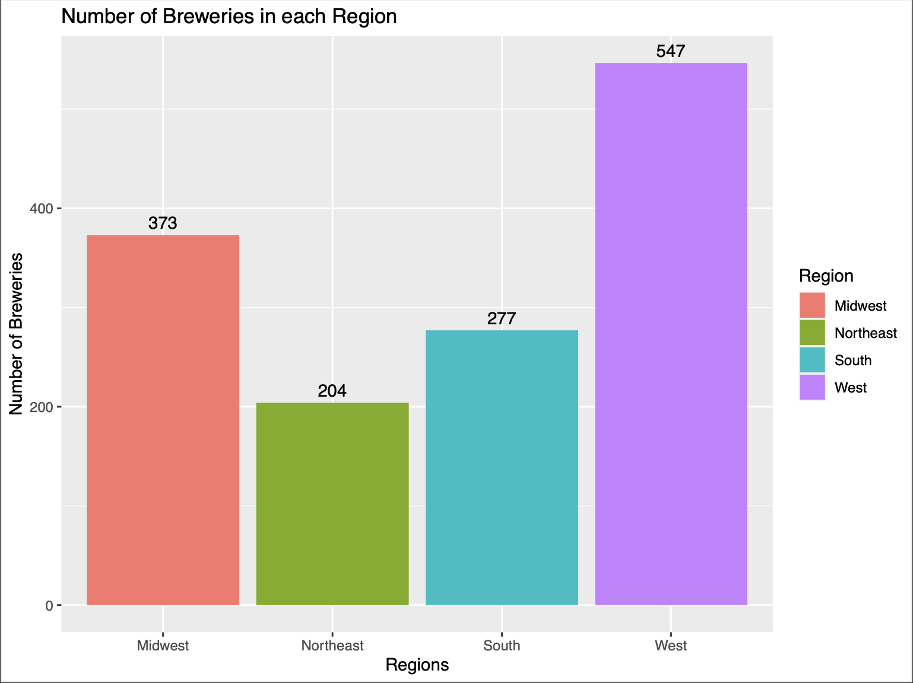
Question 9 (cont.)
The Midwest and the South have the fewest number of breweries.
Notes:
If we closely look at the number of breweries in each region, the Northeast and the South have the lowest number of breweries.

Slide 14
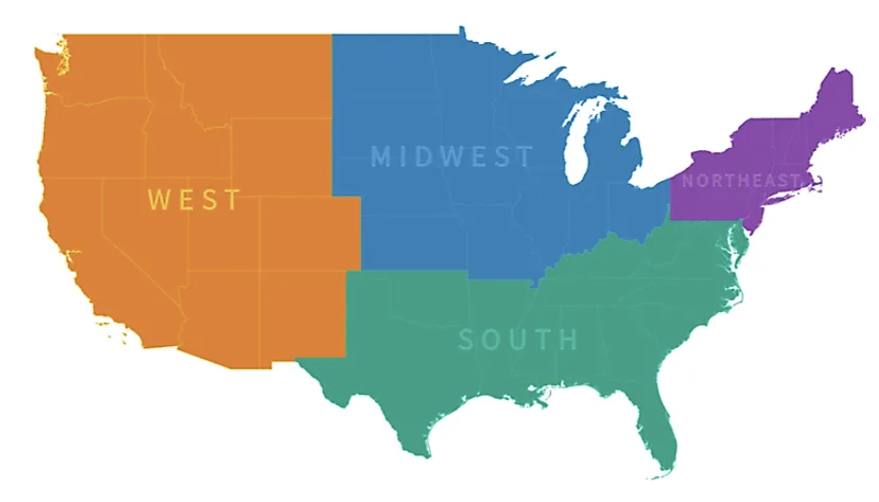
Question 9 (cont.)
68,329,004
55,982,803
78,347,268
125,580,448
Notes:
The regions with the smallest populations are in the Northeast and Midwest, which represent 17.1% and 20.8% of the population respectively.
The regions with the largest populations are in the West and the South, which represent 23.9% and 38.3% of the population respectively.
The Northeast has the smallest population and appears to have the least amount of land, so it makes sense that the region has the fewest number of breweries.
However, the South has the largest population and appears to have a lot land. Maybe budweiser should consider branching out more in the South?

Slide 15
Thank you!
Q&A
Youtube URL link:https://youtu.be/O8n-nD5LM78
Github URL link:https://github.com/maojiex/case_study_one

